Slide 1
CSE 502: Computer Architecture
Memory Hierarchy & Caches

Slide 2
Motivation
Processor
Memory
Want memory to appear:
As fast as CPU
As large as required by all of the running applications

Slide 3
Storage Hierarchy
Make common case fast:
Common: temporal & spatial locality
Fast: smaller more expensive memory
Registers
Caches (SRAM)
Memory (DRAM)
[SSD? (Flash)]
Disk (Magnetic Media)
Controlled by Hardware
Bigger Transfers
Larger
Cheaper
More Bandwidth
Faster
Controlled by Software (OS)
What is S(tatic)RAM vs D(dynamic)RAM?

Slide 4
Caches
An automatically managed hierarchy
Break memory into blocks (several bytes) and transfer data to/from cache in blocks
spatial locality
Keep recently accessed blocks
temporal locality
Core
$
Memory

Slide 5
Cache Terminology
block (cache line): minimum unit that may be cached
frame: cache storage location to hold one block
hit: block is found in the cache
miss: block is not found in the cache
miss ratio: fraction of references that miss
hit time: time to access the cache
miss penalty: time to replace block on a miss

Slide 6
Cache Example
Address sequence from core: (assume 8-byte lines)
Core
0x10000
Miss
0x10000 (…data…)
0x10004
Hit
0x10008 (…data…)
0x10120
Miss
Miss
0x10120 (…data…)
0x10008
0x10124
Hit
0x10004
Hit
Memory
Final miss ratio is 50%

Slide 7
AMAT (1/2)
Very powerful tool to estimate performance
If … cache hit is 10 cycles (core to L1 and back) memory access is 100 cycles (core to mem and back)
Then … at 50% miss ratio, avg. access: 0.5×10+0.5×100 = 55 at 10% miss ratio, avg. access: 0.9×10+0.1×100 = 19 at 1% miss ratio, avg. access: 0.99×10+0.01×100 ≈ 11

Slide 8
AMAT (2/2)
Generalizes nicely to any-depth hierarchy
If … L1 cache hit is 5 cycles (core to L1 and back) L2 cache hit is 20 cycles (core to L2 and back) memory access is 100 cycles (core to mem and back)
Then … at 20% miss ratio in L1 and 40% miss ratio in L2 … avg. access: 0.8×5+0.2×(0.6×20+0.4×100) ≈ 14

Slide 9
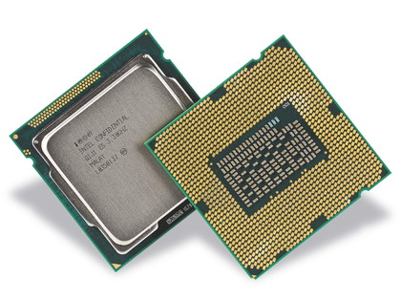
Memory Organization (1/3)
Processor
Registers
I-TLB
L1 I-Cache
L1 D-Cache
D-TLB
L2 Cache
L3 Cache (LLC)
Main Memory (DRAM)
L1 is split, L2 (here) and LLC unified

Slide 10
Memory Organization (2/3)
L1 and L2 are private
L3 is shared
Processor
Core 0
Core 1
Registers
Registers
I-TLB
L1 I-Cache
L1 D-Cache
D-TLB
I-TLB
L1 I-Cache
L1 D-Cache
D-TLB
L2 Cache
L2 Cache
L3 Cache (LLC)
Main Memory (DRAM)
Multi-core replicates the top of the hierarchy

Slide 11
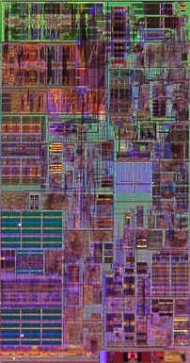
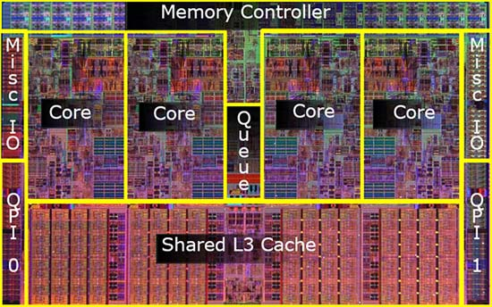
Memory Organization (3/3)
32K
L1-D
Intel Nehalem (3.3GHz, 4 cores, 2 threads per core)
256K
L2
32K
L1-I

Slide 12
SRAM Overview
1
1
0
1
0
1
“6T SRAM” cell
2 access gates
2T per inverter
b
b
Chained inverters maintain a stable state
Access gates provide access to the cell
Writing to cell involves over-powering storage inverters
Notes:
Should definitely be review for the ECE crowd.

Slide 13
8-bit SRAM Array
wordline
bitlines

Slide 14
8×8-bit SRAM Array
wordlines
bitlines

Slide 15
Fully-Associative Cache
Keep blocks in cache frames
data
state (e.g., valid)
address tag
63
address
0
tag[63:6] | block offset[5:0]
state
tag
=
data
state
tag
=
data
state
tag
=
data
state
tag
=
data
multiplexor
hit?
What happens when the cache runs out of space?

Slide 16
The 3 C’s of Cache Misses
Compulsory: Never accessed before
Capacity: Accessed long ago and already replaced
Conflict: Neither compulsory nor capacity (later today)
Coherence: (To appear in multi-core lecture)

Slide 17
Cache Size
Cache size is data capacity (don’t count tag and state)
Bigger can exploit temporal locality better
Not always better
Too large a cache
Smaller is faster → bigger is slower
Access time may hurt critical path
Too small a cache
Limited temporal locality
Useful data constantly replaced
hit rate
working set
size
capacity

Slide 18
Block Size
Block size is the data that is
Associated with an address tag
Not necessarily the unit of transfer between hierarchies
Too small a block
Don’t exploit spatial locality well
Excessive tag overhead
Too large a block
Useless data transferred
Too few total blocks
Useful data frequently replaced
hit rate
block size

Slide 19
8×8-bit SRAM Array
wordline
1-of-8 decoder
bitlines

Slide 20
64×1-bit SRAM Array
wordline
1-of-8 decoder
bitlines
column
mux
1-of-8 decoder

Slide 21
Direct-Mapped Cache
Use middle bits as index
Only one tag comparison
tag[63:16] | index[15:6] | block offset[5:0]
data
state
tag
data
state
tag
data
state
tag
decoder
data
state
tag
multiplexor
tag match (hit?)
=
Why take index bits out of the middle?

Slide 22
Cache Conflicts
What if two blocks alias on a frame?
Same index, but different tags Address sequence: 0xDEADBEEF 11011110101011011011111011101111 0xFEEDBEEF 11111110111011011011111011101111 0xDEADBEEF 11011110101011011011111011101111
0xDEADBEEF experiences a Conflict miss
Not Compulsory (seen it before)
Not Capacity (lots of other indexes available in cache)
tag
index
block offset

Slide 23
Associativity (1/2)
Where does block index 12 (b’1100) go?
Block
Set/Block
Set
0
0
0
1
0
1
1
2
0
2
3
1
1
3
4
0
4
5
2
1
5
6
0
6
7
3
1
7
Fully-associative
block goes in any frame
(all frames in 1 set)
Set-associative
block goes in any frame in one set
(frames grouped in sets)
Direct-mapped
block goes in exactly one frame
(1 frame per set)

Slide 24
Associativity (2/2)
Larger associativity
lower miss rate (fewer conflicts)
higher power consumption
Smaller associativity
lower cost
faster hit time
hit rate
~5
for L1-D
associativity

Slide 25
N-Way Set-Associative Cache
tag[63:15] | index[14:6] | block offset[5:0]
way
data
state
tag
data
state
tag
set
data
state
tag
data
state
tag
data
state
tag
data
state
tag
decoder
decoder
data
state
tag
data
state
tag
multiplexor
multiplexor
=
=
multiplexor
hit?
Note the additional bit(s) moved from index to tag

Slide 26
Associative Block Replacement
Which block in a set to replace on a miss?
Ideal replacement (Belady’s Algorithm)
Replace block accessed farthest in the future
Trick question: How do you implement it?
Least Recently Used (LRU)
Optimized for temporal locality (expensive for >2-way)
Not Most Recently Used (NMRU)
Track MRU, random select among the rest
Random
Nearly as good as LRU, sometimes better (when?)
Pseudo-LRU
Used in caches with high associativity
Examples: Tree-PLRU, Bit-PLRU

Slide 27
Victim Cache (1/2)
Associativity is expensive
Performance from extra muxes
Power from reading and checking more tags and data
Conflicts are expensive
Performance from extra mises
Observation: Conflicts don’t occur in all sets

Slide 28
Victim Cache (2/2)
Access
Sequence:
4-way Set-Associative L1 Cache
4-way Set-Associative L1 Cache
+
Fully-Associative
Victim Cache
B
C
C
A
E
D
A
E
B
A
C
B
D
D
A
B
C
C
A
B
C
D
E
J
K
L
M
A
L
B
N
X
Y
Z
X
Y
Z
J
J
N
K
L
M
J
N
K
J
L
K
M
C
M
J
K
L
L
K
P
Q
R
P
Q
R
L
D
Every access is a miss!
ABCDE and JKLMN
do not “fit” in a 4-way
set associative cache
Victim cache provides
a “fifth way” so long as
only four sets overflow
into it at the same time
M
Can even provide 6th
or 7th … ways
Provide “extra” associativity, but not for all sets
Notes:
Typically need some sort of “cast out” buffer for evictees anyway… a dirty line in a writeback cache needs to be written back to the next-level cache, and this might not be able to happen right away (e.g., bus busy, next-level cache busy, etc.). Victim cache and writeback buffer can be combined into one structure.

Slide 29
Parallel vs Serial Caches
Tag and Data usually separate (tag is smaller & faster)
State bits stored along with tags
Valid bit, “LRU” bit(s), …
Parallel access to Tag and Data reduces latency (good for L1)
Serial access to Tag and Data reduces power (good for L2+)
enable
=
=
=
=
=
=
=
=
valid?
valid?
hit?
data
hit?
data

Slide 30
Way-Prediction and Partial Tagging
Sometimes even parallel tag and data is too slow
Usually happens in high-associativity L1 caches
If you can’t wait… guess
Way Prediction Guess based on history, PC, etc…
Partial Tagging
Use part of tag to pre-select mux
prediction
=
=
=
=
=
=
=
=
valid?
valid?
=
=
=
=
=
0
=0
hit?
correct?
data
hit?
correct?
data
Guess and verify, extra cycle(s) if not correct

Slide 31
Physically-Indexed Caches
8KB pages & 512 cache sets
13-bit page offset
9-bit cache index
Core requests are VAs
Cache index is PA[14:6]
PA[12:6] == VA[12:6]
VA passes through TLB
D-TLB on critical path
PA[14:13] from TLB
Cache tag is PA[63:15]
If index size < page size
Can use VA for index
tag[63:15] | index[14:6] | block offset[5:0]
virtual page[63:13] | page offset[12:0]
Virtual Address
D-TLB
/ physical index[6:0]
(lower-bits of index from VA)
physical index[8:0] /
/
physical index[8:7]
(lower-bit of physical page number)
/
physical tag
(higher-bits of physical page number)
=
=
=
=
Simple, but slow. Can we do better?

Slide 32
Virtually-Indexed Caches
Core requests are VAs
Cache index is VA[14:6]
Cache tag is PA[63:13]
Why not PA[63:15]?
Why not tag with VA?
VA does not uniquely identify memory location
Cache flush on ctxt switch
tag[63:15] | index[14:6] | block offset[5:0]
virtual page[63:13] | page offset[12:0]
/ virtual index[8:0]
Virtual Address
D-TLB
/
physical tag
=
=
=
=

Slide 33
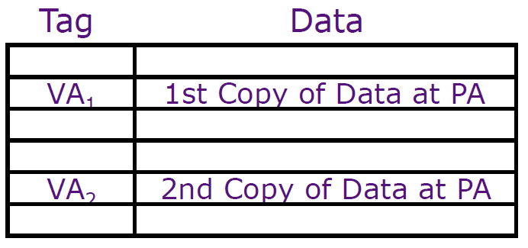
Virtually-Indexed Caches
Main problem: Virtual aliases
Different virtual addresses for same physical location
Different virtual addrs → different sets in the cache
Solution: ensure they don’t exist
Invalidate all aliases on miss
If page offset is p bits, block offset is b bits, and index is m bits, alias might exist 2m-(p-b) sets
Search all alias candidates (alias = same physical tag)
tag | m | b
page number | p
p - b
Same in VA₁ and VA₂
m - (p - b)
Different in VA₁ and VA₂

Slide 34
Multiple Accesses per Cycle
Need high-bandwidth access to caches
Core can make multiple access requests per cycle
Multiple cores can access LLC at the same time
Must either delay some requests, or…
Design SRAM with multiple ports
Big and power-hungry
Split SRAM into multiple banks
Can result in delays, but usually not

Slide 35
Multi-Ported SRAMs
Wordline₂
Wordline₁
b₂
b₁
b₁
b₂
Wordlines = 1 per port
Bitlines = 2 per port
Area = O(ports²)
Notes:
Lots of other techniques *not* discussed here such as sub-banking, hierarchical wordlines/bitlines, etc.

Slide 36
Multi-Porting vs Banking
Decoder
Decoder
Decoder
Decoder
SRAM
Array
Decoder
SRAM
Array
Decoder
SRAM
Array
S
S
Decoder
SRAM
Array
Decoder
SRAM
Array
Sense
Sense
Sense
Sense
Column
Muxing
S
S
4 ports
Big (and slow)
Guarantees concurrent access
4 banks, 1 port each
Each bank small (and fast)
Conflicts (delays) possible
How to decide which bank to go to?

Slide 37
Bank Conflicts
Banks are address interleaved
For block size b cache with N banks…
Bank = (address / b) % N
Looks more complicated than is: just low-order bits of index
Modern processors perform hashed cache indexing
May randomize bank and index
Banking can provide high bandwidth
But only if all accesses are to different banks
For 4 banks, 2 accesses, chance of conflict is 25%
tag | index | offset
no banking
tag | index | bank | offset
w/ banking

Slide 38
Write Policies
Writes are more complicated
On reads, tag and data can be accessed in parallel
On writes, needs two steps
Is access time important for writes?
Choices of Write Policies
On write hits, update memory?
Yes: write-through (higher bandwidth)
No: write-back (uses Dirty bits to identify blocks to write back)
On write misses, allocate a cache frame?
Yes: write-allocate
No: no-write-allocate

Slide 39
Inclusion
Core often accesses blocks not present on chip
Should block be allocated in L3, L2, and L1?
Called Inclusive caches
Waste of space
Requires forced evict (e.g., force evict from L1 on evict from L2+)
Only allocate blocks in L1
Called Non-inclusive caches (why not “exclusive”?)
Must write back clean lines
Some processors combine both
L3 is inclusive of L1 and L2
L2 is non-inclusive of L1 (like a large victim cache)

Slide 40
Parity & ECC
Cosmic radiation can strike at any time
Especially at high altitude
Or during solar flares
What can be done?
Parity
1 bit to indicate if sum is odd/even (detects single-bit errors)
Error Correcting Codes (ECC)
Generally SECDED (Single-Error-Correct, Double-Error-Detect)
8 bit code per 64-bit word
Detecting errors on clean cache lines is harmless
Pretend it’s a cache miss and go to memory
0 1
0 1
1 0
0 1
1 0
0 1
1 0
0 1
0 1

