Slide 1
CSE 502:
Computer Architecture
Memory / DRAM

Slide 2
SRAM vs. DRAM
SRAM = Static RAM
  As long as power is present, data is retained
DRAM = Dynamic RAM
  If you don’t do anything, you lose the data
SRAM: 6T per bit
  built with normal high-speed CMOS technology
DRAM: 1T per bit (+1 capacitor)
  built with special DRAM process optimized for density
Notes:
Again, should be review for ECE students… CS students may not have seen this type of stuff.

Slide 3
Hardware Structures
SRAM
DRAM
wordline
wordline
Trench Capacitor
b
b
b

Slide 4
DRAM Chip Organization (1/2)
Row
Address
decoder
Sense Amps
Column
Address
Row Buffer
multiplexor
  DRAM is much denser than SRAM

Slide 5
DRAM Chip Organization (2/2)
Low-Level organization is very similar to SRAM
Cells are only single-ended
  Reads destructive: contents are erased by reading
Row buffer holds read data
  Data in row buffer is called a DRAM row
    Often called “page” - not necessarily same as OS page
  Read gets entire row into the buffer
  Block reads always performed out of the row buffer
    Reading a whole row, but accessing one block
    Similar to reading a cache line, but accessing one word

Slide 6
Destructive Read
1
0
sense amp output
V_{dd}
V_{dd}
bitline
voltage
Wordline Enabled
Sense Amp Enabled
Wordline Enabled
Sense Amp Enabled
V_{dd}
V_{dd}
capacitor
voltage
  After read of 0 or 1, cell contents close to ½

Slide 7
DRAM Read
After a read, the contents of the DRAM cell are gone
  But still “safe” in the row buffer
Write bits back before doing another read
Reading into buffer is slow, but reading buffer is fast
  Try reading multiple lines from buffer (row-buffer hit)
DRAM cells
Sense Amps
Row Buffer
  Process is called opening or closing a row

Slide 8
DRAM Refresh (1/2)
Gradually, DRAM cell loses contents
  Even if it’s not accessed
  This is why it’s called “dynamic”
DRAM must be regularly read and re-written
  What to do if no read/write to row for long time?
1
0
Gate Leakage
V_{dd}
capacitor
voltage
Long Time
  Must periodically refresh all contents

Slide 9
DRAM Refresh (2/2)
Burst Refresh
  Stop the world, refresh all memory
Distributed refresh
  Space out refresh one row at a time
  Avoids blocking memory for a long time
Self-refresh (low-power mode)
  Tell DRAM to refresh itself
  Turn off memory controller
  Takes some time to exit self-refresh

Slide 10
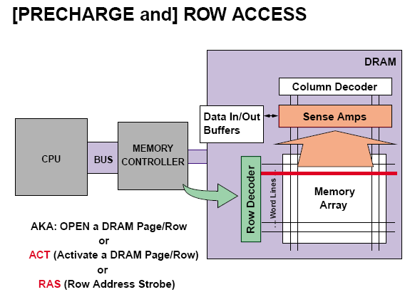
Typical DRAM Access Sequence (1/5)

Slide 11
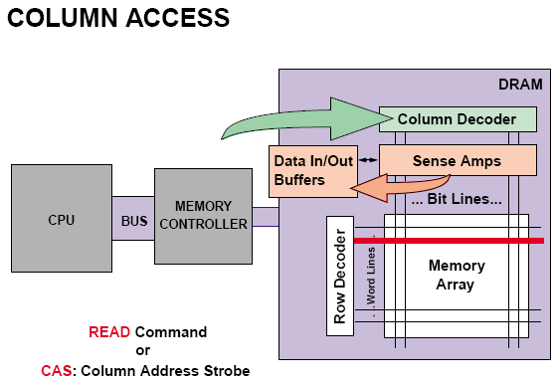
Typical DRAM Access Sequence (2/5)

Slide 12
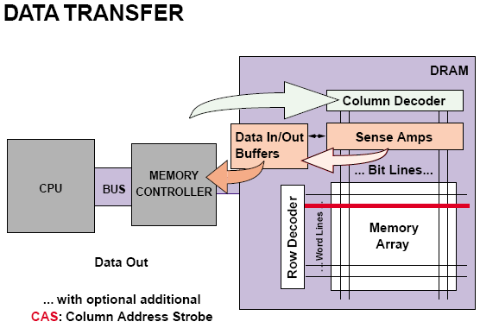
Typical DRAM Access Sequence (3/5)

Slide 13
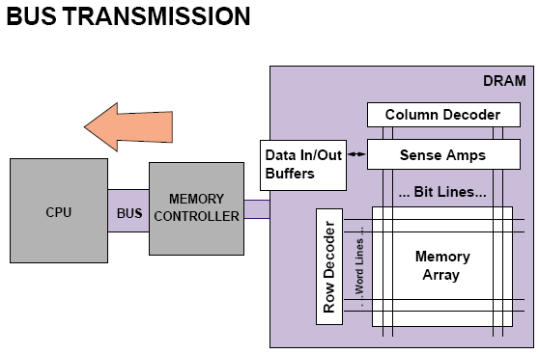
Typical DRAM Access Sequence (4/5)

Slide 14
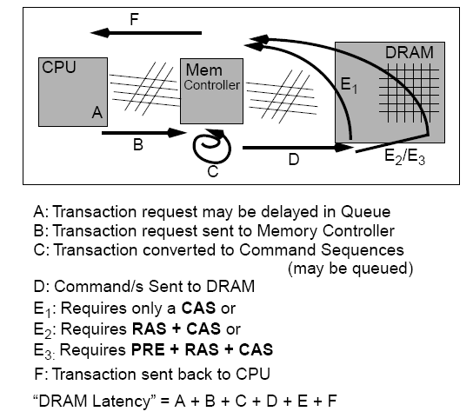
Typical DRAM Access Sequence (5/5)

Slide 15
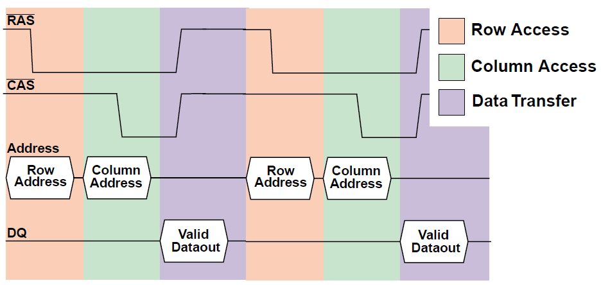
DRAM Read Timing
  Original DRAM specified Row & Column every time

Slide 16
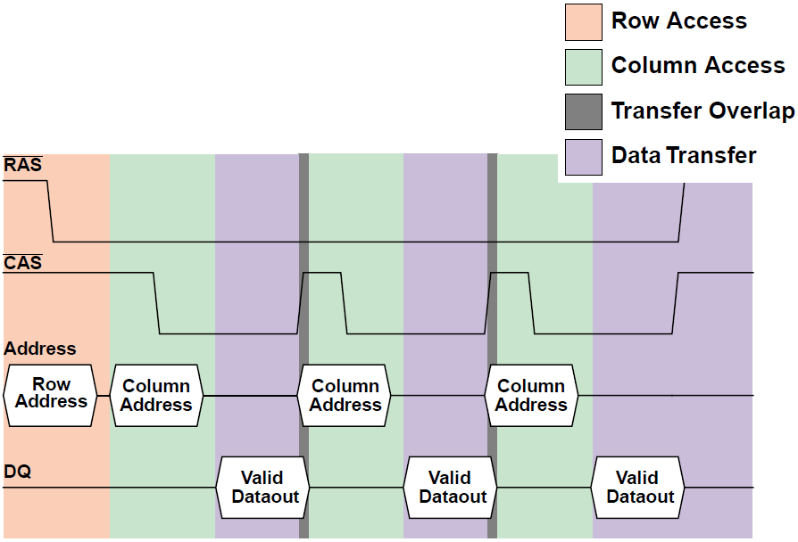
DRAM Read Timing with Fast-Page Mode
  FPM enables multiple reads from page without RAS

Slide 17
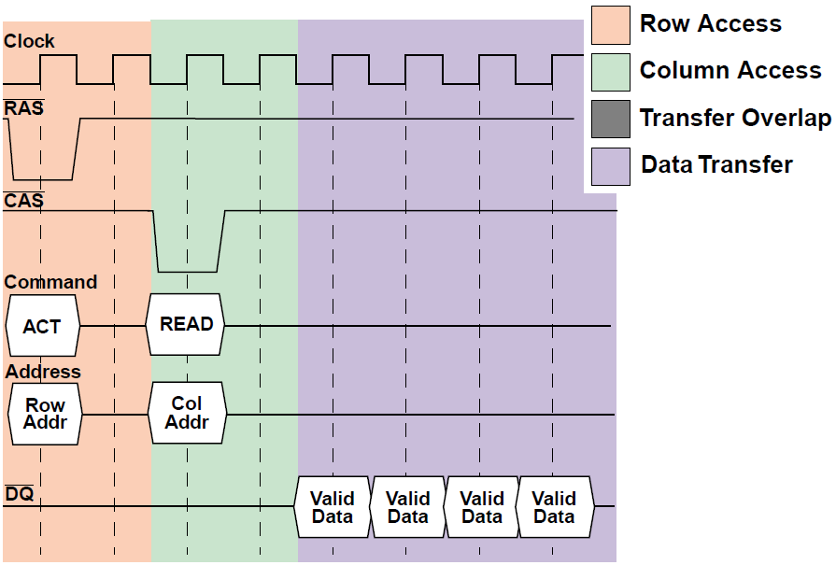
SDRAM Read Timing
Double-Data Rate (DDR) DRAM
transfers data on both rising and
falling edge of the clock
  SDRAM uses clock, supports bursts

Slide 18
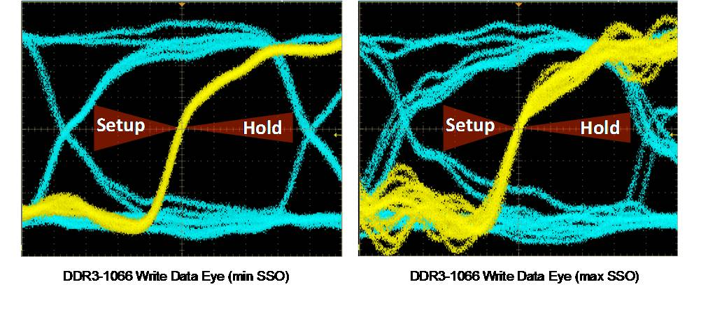
Actual DRAM Signals

Slide 19
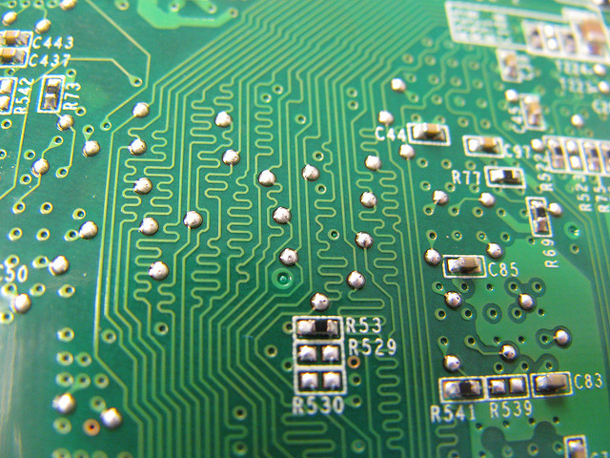
DRAM Signal Timing
  Distance matters, even at the speed of light

Slide 20
Examining Memory Performance
Miss penalty for an 8-word cache block
  1 cycle to send address
  6 cycles to access each word
  1 cycle to send word back
  ( 1 + 6 + 1) x 8 = 64
(Expensive) Wider bus option
  Read all words in parallel
Miss penalty for 8-word block: 1 + 6 + 1 = 8

Slide 21
Simple Interleaved Main Memory
Divide memory into n banks
  “interleave” addresses across them
Access one bank while another is busy
  Increases bandwidth w/o a wider bus
Bank 0
Bank 1
Bank 2
Bank n
word 0
word 1
word 2
word n-1
word n
word n+1
word n+2
word 2n-1
word 2n
word 2n+1
word 2n+2
word 3n-1
PA
Bank
Word offset
  Use parallelism in memory banks to hide latency

Slide 22
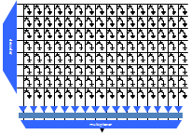
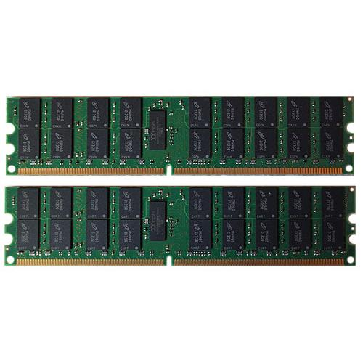
DRAM Organization
DIMM
x8 DRAM
All banks within the
rank share all address
and control pins
DRAM
Rank
DRAM
DRAM
DRAM
Bank
DRAM
DRAM
All banks are independent,
but can only talk to one
bank at a time
DRAM
DRAM
DRAM
DRAM
x8 means each DRAM
outputs 8 bits, need 8
chips for DDRx (64-bit)
DRAM
DRAM
DRAM
DRAM
x8 DRAM
Why 9 chips per rank?
64 bits data, 8 bits ECC
DRAM
DRAM
DRAM
DRAM
  Dual-rank x8 (2Rx8) DIMM

Slide 23
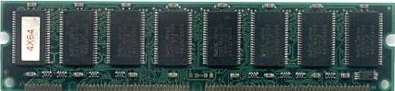
Memory Channels
One controller
One 64-bit channel
Mem Controller
Commands
Data
Mem Controller
One controller
Two 64-bit channels
Mem Controller
Two controllers
Two 64-bit channels
Mem Controller
  Use multiple channels for more bandwidth

Slide 24
Address Mapping Schemes (1/3)
Map consecutive addresses to improve performance
Multiple independent channels → max parallelism
  Map consecutive cache lines to different channels
Multiple channels/ranks/banks → OK parallelism
  Limited by shared address and/or data pins
  Map close cache lines to banks within same rank
    Reads from same rank are faster than from different ranks
  Accessing rows from one bank is slowest
    All requests serialized, regardless of row-buffer mgmt. policies
    Rows mapped to same bank should avoid spatial locality
  Column mapping depends on row-buffer mgmt. (Why?)

Slide 25
Address Mapping Schemes (2/3)
[… … … … bank column ...]
0x00000
0x00400
0x00800
0x00C00
0x00100
0x00500
0x00900
0x00D00
0x00200
0x00600
0x00A00
0x00E00
0x00300
0x00700
0x00B00
0x00F00
[… … … … column bank …]
0x00000
0x00100
0x00200
0x00300
0x00400
0x00500
0x00600
0x00700
0x00800
0x00900
0x00A00
0x00B00
0x00C00
0x00D00
0x00E00
0x00F00

Slide 26
Address Mapping Schemes (3/3)
Example Open-page Mapping Scheme:
  High Parallelism: [row rank bank column channel offset]
  Easy Expandability: [channel rank row bank column offset]
Example Close-page Mapping Scheme:
  High Parallelism: [row column rank bank channel offset]
  Easy Expandability: [channel rank row column bank offset]

Slide 27
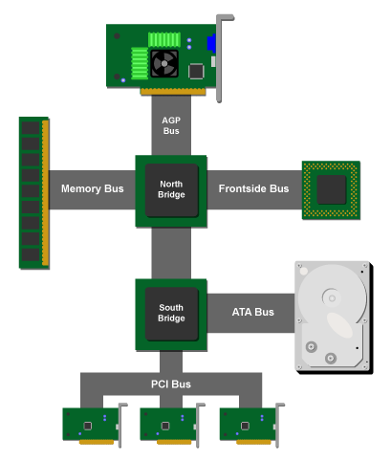
CPU-to-Memory Interconnect (1/3)
North Bridge can be
Integrated onto CPU
chip to reduce latency
Figure from ArsTechnica

Slide 28
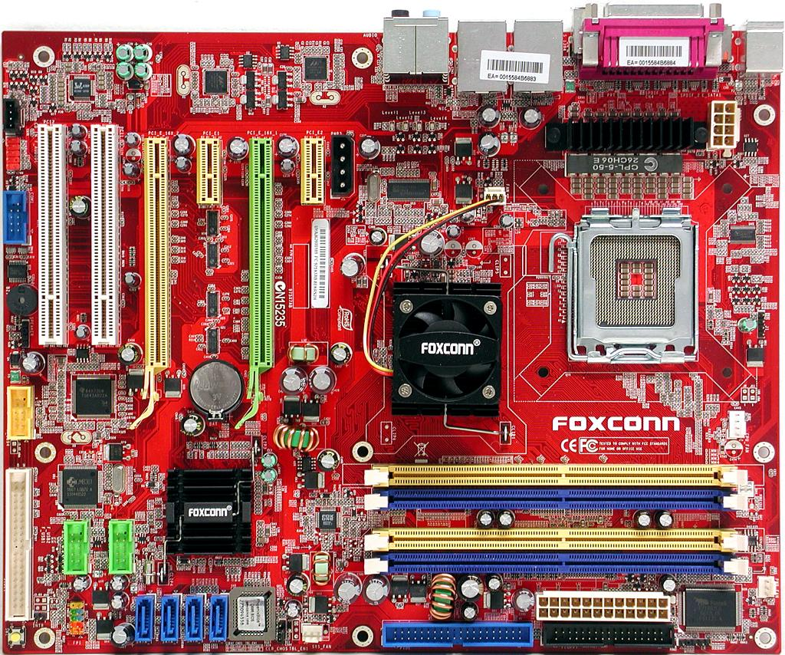
CPU-to-Memory Interconnect (2/3)
CPU
FSB
North
Bridge
Memory Bus
South Bridge
  Discrete North and South Bridge chips

Slide 29
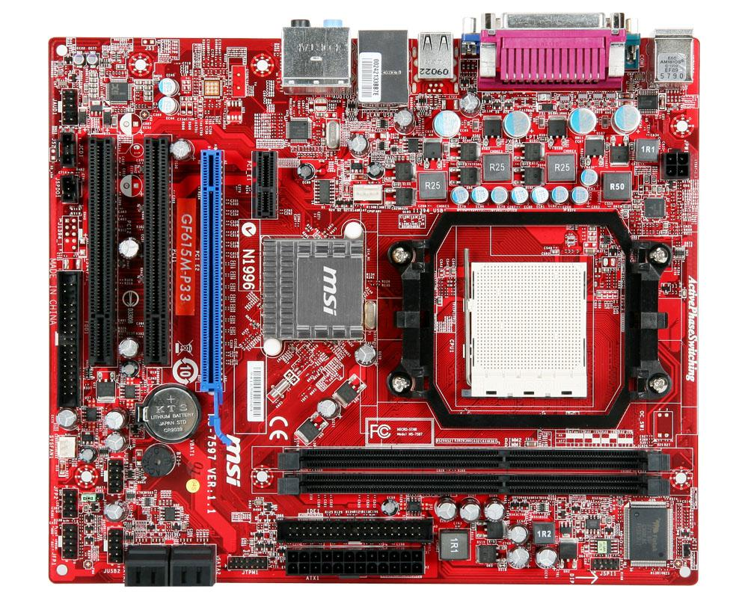
CPU-to-Memory Interconnect (3/3)
South Bridge
CPU
Memory Bus
  Integrated North Bridge

Slide 30
Memory Controller (1/2)
Read
Queue
Write
Queue
Response
Queue
Commands
Data
To/From CPU
Scheduler
Buffer
Memory
Controller
Channel 0
Channel 1

Slide 31
Memory Controller (2/2)
Memory controller connects CPU and DRAM
Receives requests after cache misses in LLC
  Possibly originating from multiple cores
Complicated piece of hardware, handles:
  DRAM Refresh
  Row-Buffer Management Policies
  Address Mapping Schemes
  Request Scheduling

Slide 32
Row-Buffer Management Policies
Open-page
  After access, keep page in DRAM row buffer
  Next access to same page → lower latency
  If access to different page, must close old one first
    Good if lots of locality
Close-page
  After access, immediately close page in DRAM row buffer
  Next access to different page → lower latency
  If access to different page, old one already closed
    Good if no locality (random access)

Slide 33
Request Scheduling (1/3)
Write buffering
  Writes can wait until reads are done
Queue DRAM commands
  Usually into per-bank queues
  Allows easily reordering ops. meant for same bank
Common policies:
  First-Come-First-Served (FCFS)
  First-Ready—First-Come-First-Served (FR-FCFS)

Slide 34
Request Scheduling (2/3)
First-Come-First-Served
  Oldest request first
First-Ready—First-Come-First-Served
  Prioritize column changes over row changes
  Skip over older conflicting requests
  Find row hits (on queued reqs., even if close-page policy)
  Find oldest
    If no conflicts with in-progress request → good
    Otherwise (if conflicts), try next oldest

Slide 35
Request Scheduling (3/3)
Why is it hard?
Tons of timing constraints in DRAM
  tWTR: Min. cycles before read after a write
  tRC: Min. cycles between consecutive open in bank
  …
Simultaneously track resources to prevent conflicts
  Channels, banks, ranks, data bus, address bus, row buffers
  Do it for many queued requests at the same time
  … while not forgetting to do refresh

Slide 36
Memory-Level Parallelism (MLP)
What if memory latency is 10000 cycles?
  Runtime dominated by waiting for memory
  What matters is overlapping memory accesses
Memory-Level Parallelism (MLP):
  “Average number of outstanding memory accesses when at least one memory access is outstanding.”
MLP is a metric
  Not a fundamental property of workload
  Dependent on the microarchitecture

Slide 37
AMAT with MLP
If …
cache hit is 10 cycles (core to L1 and back)
memory access is 100 cycles (core to mem and back)
Then …
at 50% miss ratio, avg. access: 0.5×10+0.5×100 = 55
Unless MLP is >1.0, then…
at 50% mr,1.5 MLP,avg. access:(0.5×10+0.5×100)/1.5 = 37
at 50% mr,4.0 MLP,avg. access:(0.5×10+0.5×100)/4.0 = 14
  In many cases, MLP dictates performance

Slide 38
Overcoming Memory Latency
Caching
  Reduce average latency by avoiding DRAM altogether
  Limitations
    Capacity (programs keep increasing in size)
    Compulsory misses
Memory-Level Parallelism
  Perform multiple concurrent accesses
Prefetching
  Guess what will be accessed next
    Put in into the cache

