Slide 1
Review and Background

Slide 2
Amdahl’s Law
Speedup = time_{without enhancement} / time_{with enhancement}
An enhancement speeds up fraction f of a task by factor S
time_{new} = time_{orig}·( (1-f) + f/S )
S_{overall} = 1 / ( (1-f) + f/S )
time_{orig}
time_{orig}
time_{orig}
1
(1 - f)
f
(1 - f)
f
time_{new}
time_{new}
(1 - f)
f/S
(1 - f)
f/S
Notes:
Real life analogy: After driving through 60 minutes of traffic jam, how much time can you make up by speeding in the final mile?
Applications in Computer Architecture
RISC - Reduced Instruction Set Computer
Optimized to execute frequently used instructions quickly
Infrequently used instructions can take a long time, or even emulated by software
We should concentrate efforts on improving frequently occurring events or frequently used mechanisms

Slide 3
The Iron Law of Processor Performance
Total Work
In Program
CPI or 1/IPC
1/f (frequency)
Algorithms,
Compilers,
ISA Extensions
Microarchitecture
Microarchitecture,
Process Tech
  We will concentrate on CPI, others are important too!

Slide 4
Performance
Latency (execution time): time to finish one task
Throughput (bandwidth): number of tasks/unit time
  Throughput can exploit parallelism, latency can’t
  Sometimes complimentary, often contradictory
Example: move people from A to B, 10 miles
  Car: capacity = 5, speed = 60 miles/hour
  Bus: capacity = 60, speed = 20 miles/hour
  Latency: car = 10 min, bus = 30 min
  Throughput: car = 15 PPH (count return trip), bus = 60 PPH
  No right answer: pick metric for your goals

Slide 5
Performance Improvement
Processor A is X times faster than processor B if
  Latency(P,A) = Latency(P,B) / X
  Throughput(P,A) = Throughput(P,B) * X
Processor A is X% faster than processor B if
  Latency(P,A) = Latency(P,B) / (1+X/100)
  Throughput(P,A) = Throughput(P,B) * (1+X/100)
Car/bus example
  Latency? Car is 3 times (200%) faster than bus
  Throughput? Bus is 4 times (300%) faster than car

Slide 6
Partial Performance Metrics Pitfalls
Which processor would you buy?
  Processor A: CPI = 2, clock = 2.8 GHz
  Processor B: CPI = 1, clock = 1.8 GHz
  Probably A, but B is faster (assuming same ISA/compiler)
Classic example
  800 MHz Pentium III faster than 1 GHz Pentium 4
  Same ISA and compiler

Slide 7
Averaging Performance Numbers (1/2)
Latency is additive, throughput is not
  Latency(P1+P2,A) = Latency(P1,A) + Latency(P2,A)
  Throughput(P1+P2,A) != Throughput(P1,A)+Throughput(P2,A)
Example:
  180 miles @ 30 miles/hour + 180 miles @ 90 miles/hour
  6 hours at 30 miles/hour + 2 hours at 90 miles/hour
    Total latency is 6 + 2 = 8 hours
    Total throughput is not 60 miles/hour
      Total throughput is only 45 miles/hour! (360 miles / (6 + 2 hours))
  Arithmetic mean is not always the answer!

Slide 8
Averaging Performance Numbers (2/2)
Arithmetic: times
  proportional to time
  e.g., latency
Harmonic: rates
  inversely proportional to time
  e.g., throughput
Geometric: ratios
  unit-less quantities
  e.g., speedups
  Memorize these to avoid looking them up later

Slide 9
Parallelism: Work and Critical Path
Parallelism: number of independent tasks available
Work (T1): time on sequential system
Critical Path (T∞): time on infinitely-parallel system
Average Parallelism:
P_{avg} = T1 / T∞
For a p-wide system:
T_{p} ≥ max{ T1/p, T∞ }
P_{avg} >> p ⇒ T_{p} ≈ T1/p
x = a + b;
y = b * 2
z =(x-y) * (x+y)
  Can trade off frequency for parallelism

Slide 10
Locality Principle
Recent past is a good indication of near future
  Temporal Locality: If you looked something up, it is very likely that you will look it up again soon
  Spatial Locality: If you looked something up, it is very likely you will look up something nearby soon
Notes:
Real life analogy:
spatial locality - where you choose to sit in a room
temporal locality - will you be here again next week?
Examples in computer architecture:
Execution of program loops
spatial locality - after you execute an instruction, with very good probability, you will execute the next instruction
temporal locality - you are very likely to repeat the same instructions many times

Slide 11
Power vs. Energy (1/2)
Power: instantaneous rate of energy transfer
  Expressed in Watts
  In Architecture, implies conversion of electricity to heat
  Power(Comp1+Comp2)=Power(Comp1)+Power(Comp2)
Energy: measure of using power for some time
  Expressed in Joules
  power * time (joules = watts * seconds)
  Energy(OP1+OP2)=Energy(OP1)+Energy(OP2)
What uses power in a chip?

Slide 12
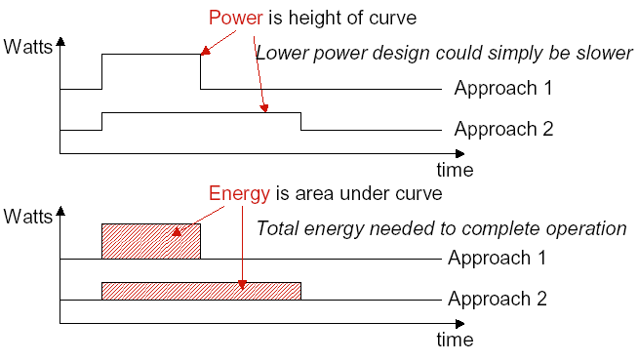
Power vs. Energy (2/2)

Slide 13
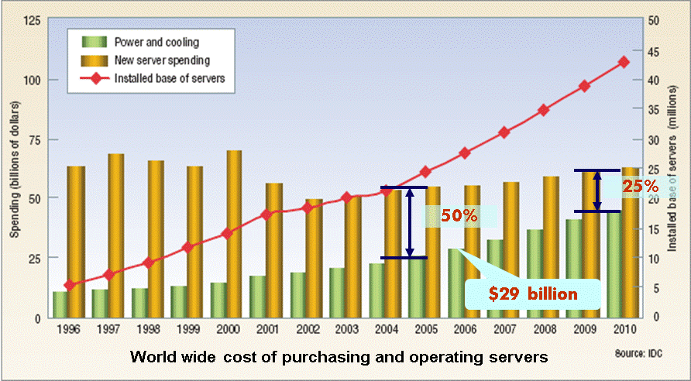
Why is energy important?
Because electricity consumption has costs
  Impacts battery life for mobile
  Impacts electricity costs for tethered
    Delivering power for buildings, countries
    Gets worse with larger data centers ($7M for 1000 racks)

Slide 14
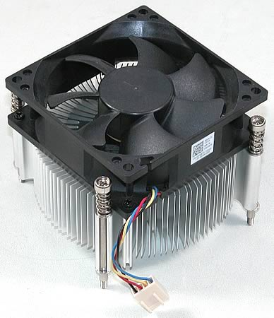
Why is power important?
Because power has a peak
All power “spent” is converted to heat
  Must dissipate the heat
  Need heat sinks and fans
What if fans not fast enough?
  Chip powers off (if it’s smart enough)
  Melts otherwise
Thermal failures even when fans OK
  50% server reliability degradation for +10°C
  50% decrease in hard disk lifetime for +15°C

Slide 15
Power
Dynamic power vs. Static power
  Static: “leakage” power
  Dynamic: “switching” power
Static power: steady, constant energy cost
Dynamic power: transitions from 0→1 and 1→0
What uses power in a chip?

Slide 16

Power: The Basics (1/2)
Dynamic Power
  Related to switching activity of transistors (from 0→1 and 1→0)
Dynamic Power $∝CV_{dd}^{ 2}Af$
  C: capacitance, function of transistor size and wire length
  V_{dd}: Supply voltage
  A: Activity factor (average fraction of transistors switching)
  f: clock frequency
  About 50-70% of processor power
Gate
Gate
Applied Voltage
+ + + + +
Current
Source
Drain
- - - - -
Current
Threshold Voltage
Source
Drain

Slide 17

Power: The Basics (2/2)
Static Power
  Current leaking from a transistor even if doing nothing (steady, constant energy cost)
Static Power $∝ V_{dd}$ and $∝e^{−c_{1}V_{th}}$ and $∝ e^{c_{2}T}$
  This is a first-order model
  $c_{1}$, $c_{2}$ : some positive constants
  $V_{th}$: Threshold Voltage
  $T$: Temperature
  About 30-50% of processor power
Gate Leakage
Channel Leakage
Sub-threshold Conductance

Slide 18
Thermal Runaway
Leakage is an exponential function of temperature
⬆ Temp leads to ⬆ Leakage
Which burns more power
Which leads to ⬆ Temp, which leads to…
  Positive feedback loop will melt your chip

Slide 19

Why Power Became an Issue? (1/2)
Ideal scaling was great (aka Dennard scaling)
  Every new semiconductor generation:
    Transistor dimension: x 0.7
    Transistor area: x 0.5
    C and V_{dd}: x 0.7
    Frequency: 1 / 0.7 = 1.4
  Constant dynamic power density
  In those good old days, leakage was not a big deal
Dynamic Power:
$$CV_{dd}^{ 2}Af$$
  40% faster and 2x more transistors at same power

Slide 20
Why Power Became an Issue? (2/2)
Recent reality: V_{dd} does not decrease much
  Switching speed is roughly proportional to V_{dd} - V_{th}
    If too close to threshold voltage (V_{th}) → slow transistor
    Fast transistor & low V_{dd} → low V_{th} → exponential leakage increase ✗
  Dynamic power density keeps increasing
  Leakage power has also become a big deal today
    Due to lower Vth, smaller transistors, higher temperatures, etc.
Example: power consumption in Intel processors
  Intel 80386 consumed ~ 2 W
  3.3 GHz Intel Core i7 consumes ~ 130 W
  Heat must be dissipated from 1.5 x 1.5 cm² chip
  This is the limit of what can be cooled by air
Referred to as the Power Wall

Slide 21
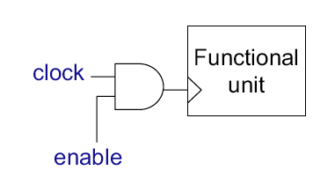
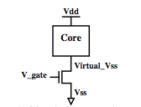
How to Reduce Power? (1/3)
Clock gating
  Stop switching in unused components
  Done automatically in most designs
  Near instantaneous on/off behavior
Power gating
  Turn off power to unused cores/caches
  High latency for on/off
    Saving SW state, flushing dirty cache lines, turning off clock tree
    Carefully done to avoid voltage spikes or memory bottlenecks
  Issue: Area & power consumption of power gate
  Opportunity: use thermal headroom for other cores

Slide 22
How to Reduce Power? (2/3)
Reduce Voltage (V): quadratic effect on dyn. power
  Negative (~linear) effect on frequency
Dynamic Voltage/Frequency Scaling (DVFS): set frequency to the lowest needed
  Execution time = IC * CPI * f
Scale back V to lowest for that frequency
  Lower voltage → slower transistors
  Dyn. Power ≈ C * V² * F
Not Enough! Need Much More!

Slide 23
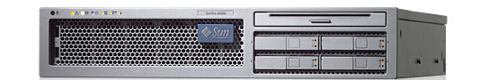
Processor Is Not Alone
SunFire T2000
< ¼ System Power
> ½ CPU Power
Need whole-system approaches to save energy

Slide 24
ISA: A contract between HW and SW
ISA: Instruction Set Architecture
  A well-defined hardware/software interface
The “contract” between software and hardware
  Functional definition of operations supported by hardware
  Precise description of how to invoke all features
No guarantees regarding
  How operations are implemented
  Which operations are fast and which are slow (and when)
  Which operations take more energy (and which take less)

Slide 25
Components of an ISA
Programmer-visible states
  Program counter, general purpose registers,
  memory, control registers
Programmer-visible behaviors
  What to do, when to do it
A binary encoding
if imem[rip]==“add rd, rs, rt”
then
rip ⇐ rip+1
gpr[rd]=gpr[rs]+grp[rt]
Example “register-transfer-level”
description of an instruction
  ISAs last forever, don’t add stuff you don’t need

Slide 26
RISC vs. CISC
Recall Iron Law:
  (instructions/program) * (cycles/instruction) * (seconds/cycle)
CISC (Complex Instruction Set Computing)
  Improve “instructions/program” with “complex” instructions
  Easy for assembly-level programmers, good code density
RISC (Reduced Instruction Set Computing)
  Improve “cycles/instruction” with many single-cycle instructions
  Increases “instruction/program”, but hopefully not as much
    Help from smart compiler
  Perhaps improve clock cycle time (seconds/cycle)
    via aggressive implementation allowed by simpler instructions
  Today’s x86 chips translate CISC into ~RISC

Slide 27
Prototypical Processor Organization
Addr-gen.
Fetch
Decode
Issue
Execute
Memory
(Write-back)
+4
Instruction
Access
Register
File
Data
Access
PC
ALU

